Slide 1
Heterogeneous Effects of Medicaid Expansions on County-Level Uninsurance Rates: Structural Nested Mean Models Fit Under Parallel Trends Assumptions
Meghana G. Shamsunder, PhD(c), MPH
Joint work with: Zach Shahn, Mustafa Hussein, Samantha Raymond, Dahlia Remler
CUNY Graduate School of Public Health and Health Policy
Twitter: @meghademiology

Slide 2
Outline
The Question: How do effects of Medicaid expansion on uninsurance rates vary with county level characteristics?
Methods:
Basic DiD and Parallel Trends Assumption
Time Varying DiD
G-Estimation of SNMMs
Results
Notes:
We’ll begin with our research question and applying existing DiD methods, highlighting how these methods don’t quite get at the questions we care about. We’ll then move into applying the proposed method (g-estimation of structural nested mean models or SNMMS fit under a parallel trends assumption) which does directly address our research questions - and we’ll show you the results at the end

Slide 3
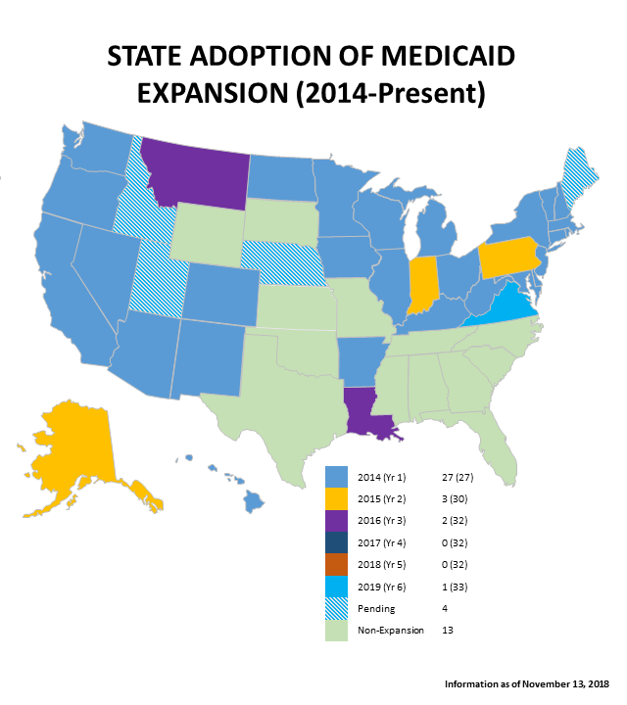
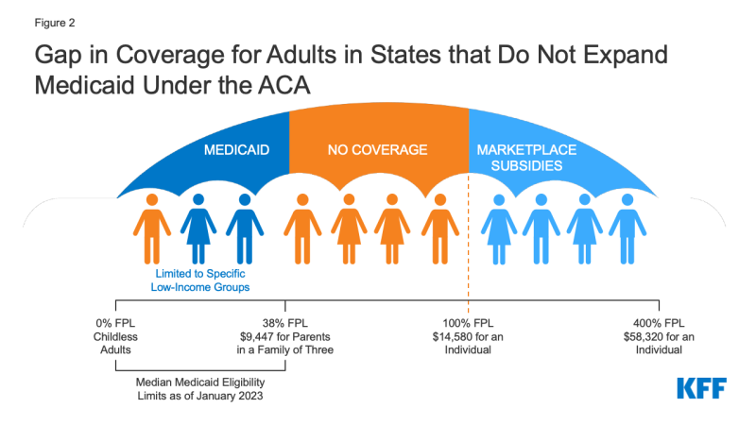
The Question
Methods: DiD
Methods: Econ
Results
Methods: Epi
Medicaid Expansion and
Uninsurance Rates
What is the effect of state Medicaid expansion on county-level uninsurance rates in adults 18-64 at or below the 138% federal poverty line?
How does the effect of expansion vary by county population and prior income eligibility thresholds/state generosity?
Notes:
Prior to expansion, Medicaid eligibility income thresholds varied across states. But after expansion, eligibility for childless adults increased to 138% of the FPL.
Apart from assessing the time-varying treatment effect of expansion on county-level uninsurance rates, we wanted to look at effect heterogeneity. For example, one might expect the impact of expansion to be greater in areas that had less generous thresholds prior to expansion. Also there is some evidence showing that expansion had a greater impact on uninsurance rates in low population areas. We wanted to look at these effect modifiers and quantify the heterogeneity.
>>
https://www.healthmanagement.com/blog/medicaid-expansion-considerations-non-expansion-states/
https://www.kff.org/medicaid/issue-brief/how-many-uninsured-are-in-the-coverage-gap-and-how-many-could-be-eligible-if-all-states-adopted-the-medicaid-expansion/

Slide 4
The Question
Methods: DiD
Methods: Econ
Results
Methods: Epi
Canonical DiD
Pre-Treatment Period
Treatment Period
Outcome
Post Treatment Difference
Counterfactual Outcome
Pre-Treatment Difference
Time
Treated:
Treated had they not been treated:
Control:
Notes:
A classic way we could try answering these research questions is to use DiD. In the canonical setup, we have an intervention with 2 time points. The average treatment effect on the treated or ATT is our causal estimate which we can get by calculating
>>
the pre-treatment difference in the outcomes and
>>
taking the post treatment difference. The last step, is to calculate the difference of these differences. The ability to get an unbiased diff and diff estimate hinges on the parallel trends assumption. This assumption states that the differences in the potential outcomes in the treated, had they not been treated, and in the control remains constant over time.
>>
This assumption can be visualized by having parallel potential outcome trajectories between the 2 groups where we show with the green brace how the pre-treatment difference relates to the counterfactual untreated outcome.

Slide 5
The Question
Methods: DiD
Methods: Econ
Results
Methods: Epi
Canonical DiD
Pre-Treatment Period
Treatment Period
Outcome
Difference in the Differences
(Treatment Effect on the Treated)
Post Treatment Difference
Counterfactual Outcome
Pre-Treatment Difference
Time
Treated:
Treated had they not been treated:
Control:
Notes:
With the pre-treatment and post-treatment differences, we can see that the treatment effect on the treated is the difference of these differences, denoted by the pink brace

Slide 6
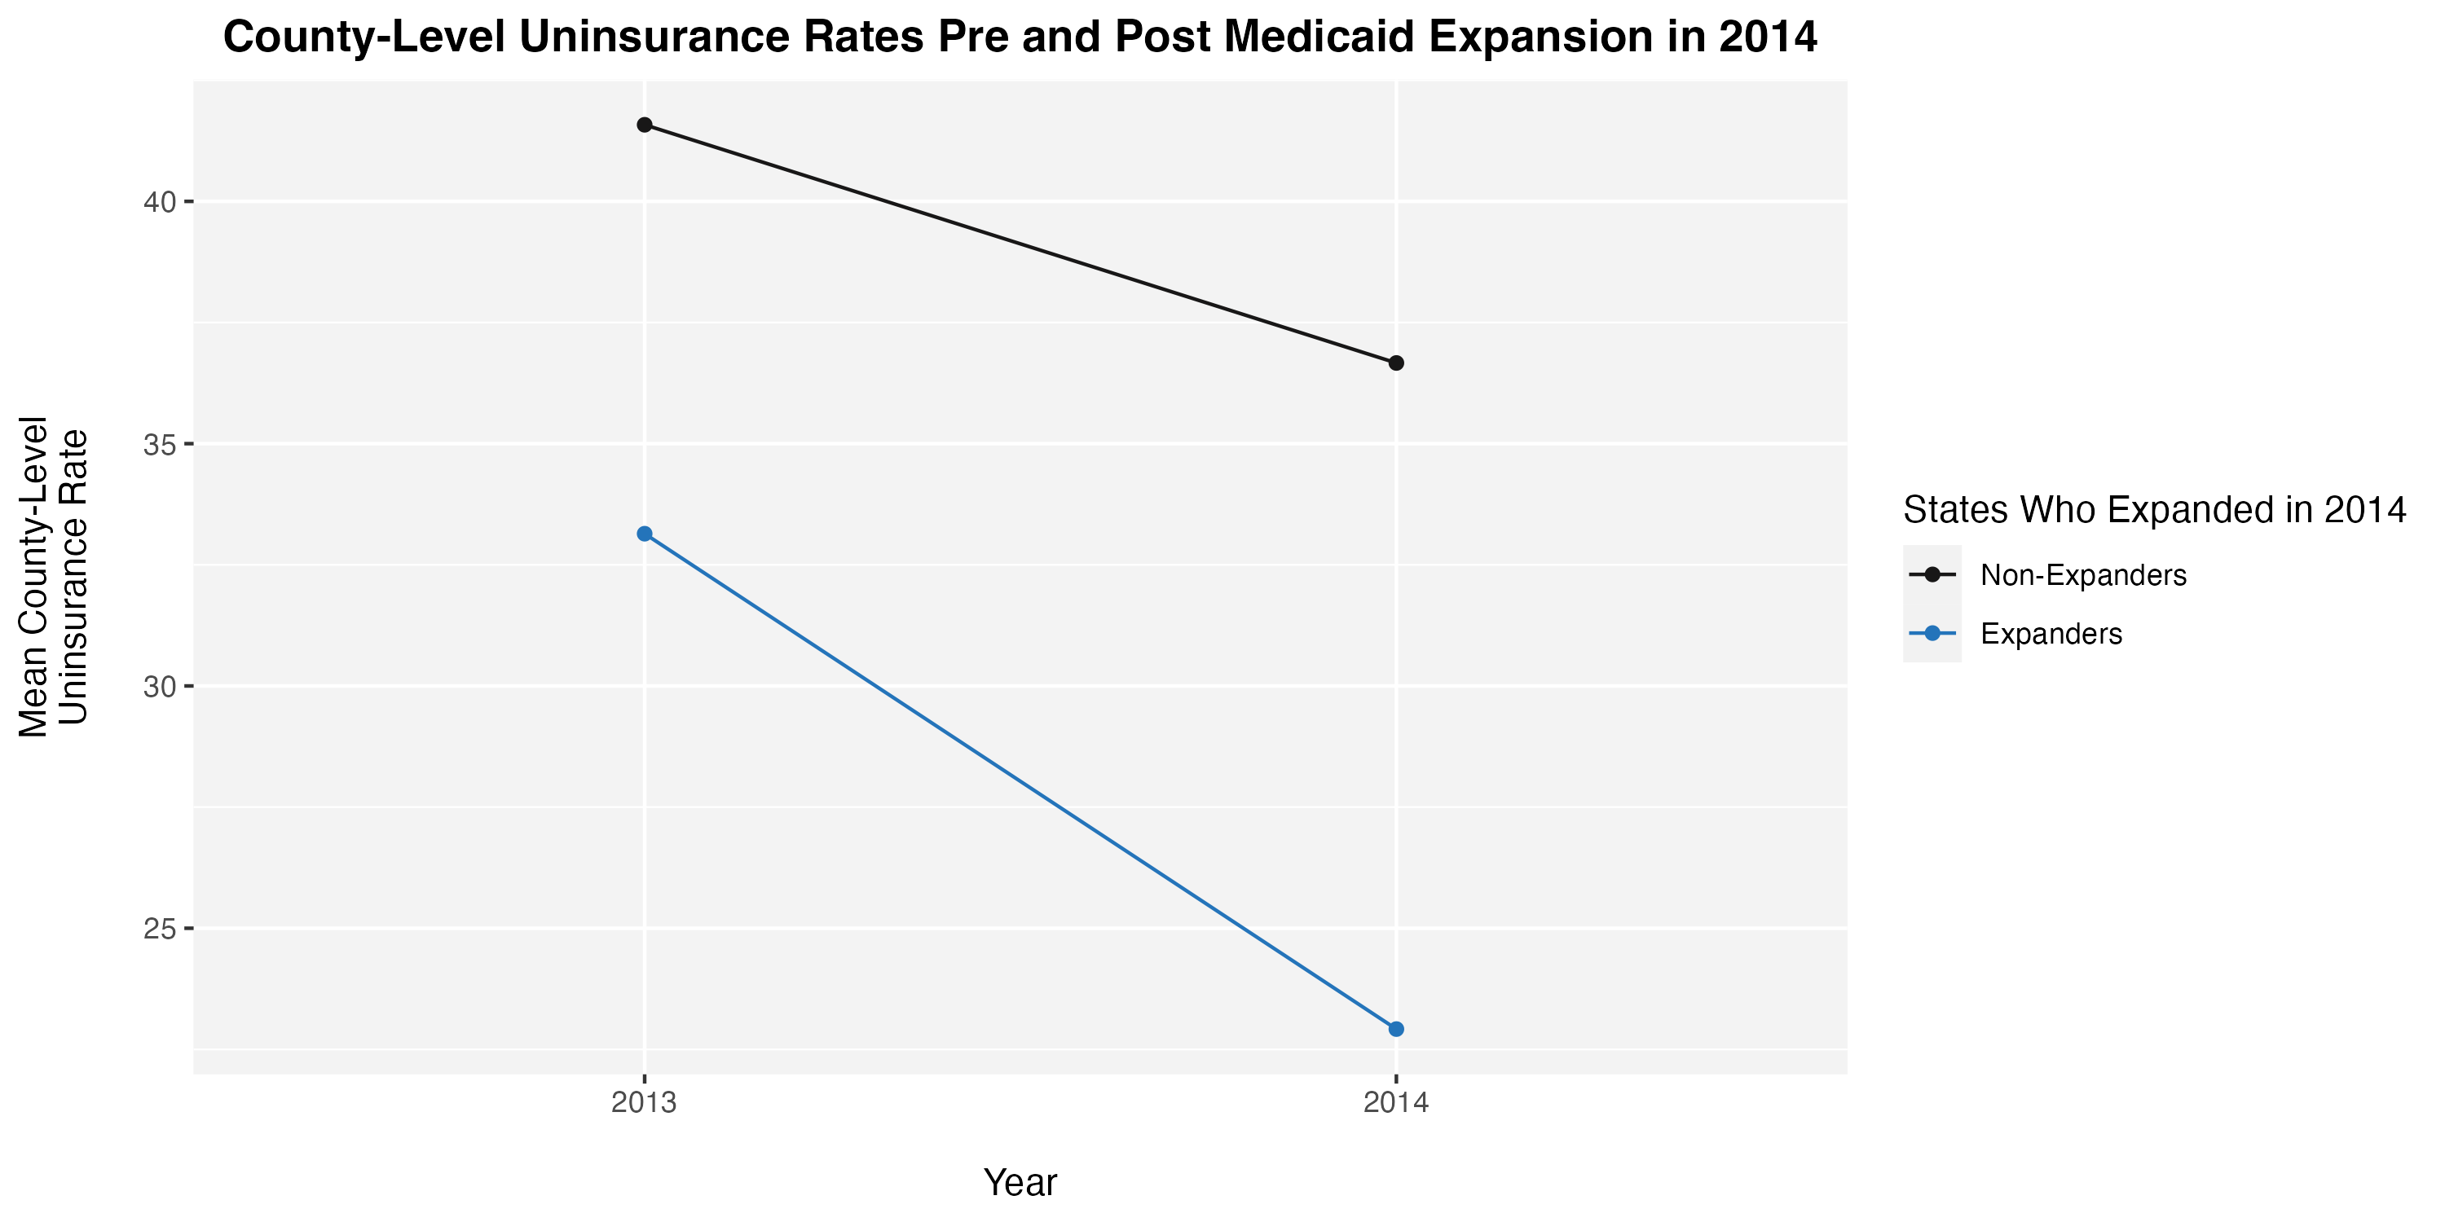
The Question
Methods: DiD
Methods: Econ
Results
Methods: Epi
Canonical DiD
Pre-Treatment Difference:
Expanders: 33.1
Non-Expanders: 41.6
Difference: -8.5
Doesn’t account for:
Staggered adoption of Medicaid expansion
Post Treatment Difference
Expanders: 22.9
Non-Expanders: 36.7
Difference: -13.8
Difference in the Differences
-5.3
Notes:
We applied the canonical DID to our Medicaid expansion study, where we compared 2014 expanders with 2014 non-expanders, got our
>>
pre and post treatment differences and a DiD estimate of -5.3%. Said differently ACA expanders experienced a 5.3% reduction in county-level uninsurance rates than 2014 non-expanders. However, using this method fails to consider
>>
the staggered adoption of Medicaid expansion and is completely unable to answer our questions on effect heterogeneity where it has been shown the analytic methods for canonical DiD studies produce biased estimates in the presence of effect heterogeneity.

Slide 7
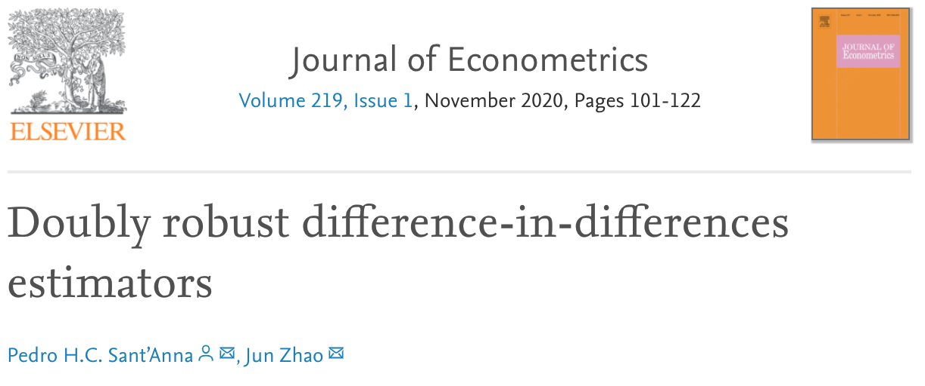
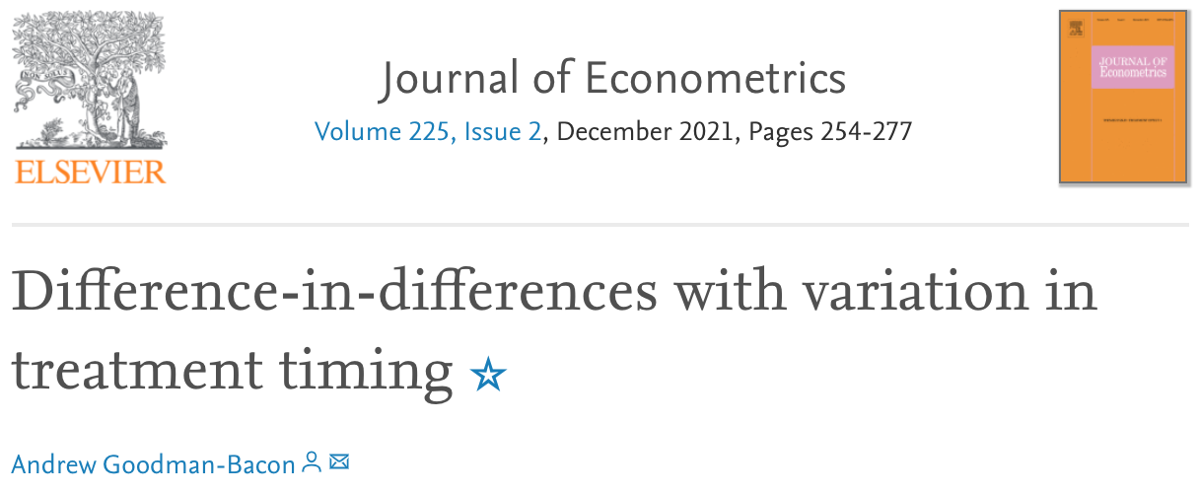
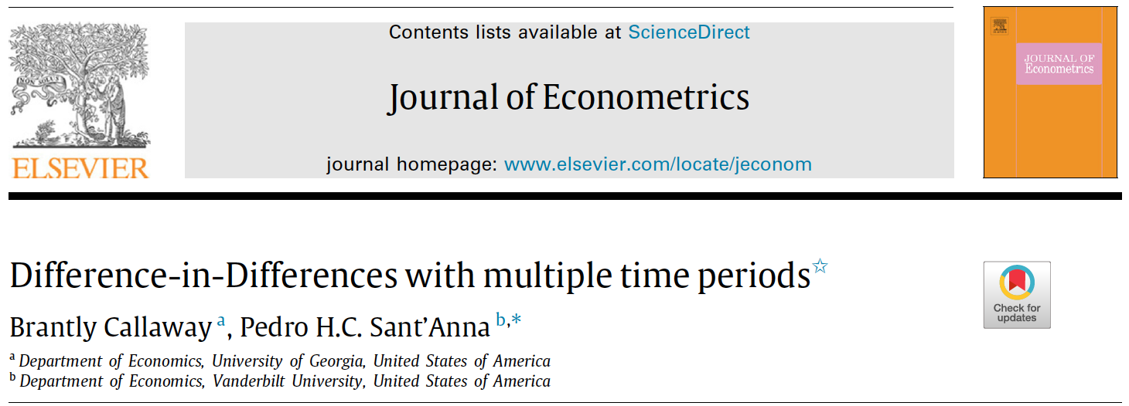
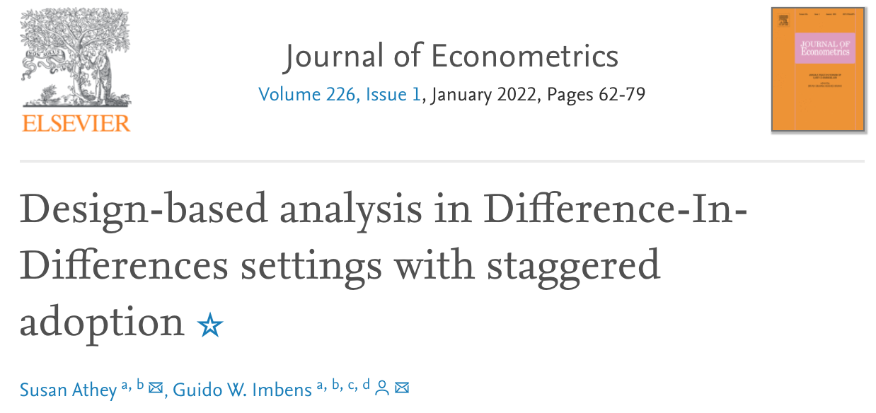
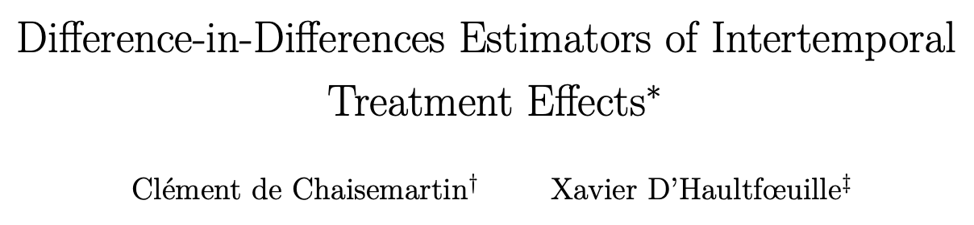
The Question
Methods: DiD
Methods: Econ
Results
Methods: Epi
Time-Varying DiD
Notes:
Ok canonical DiD wasn’t the way to go – so
>>
we took a dive into the econ literature, where, recently, there have been several papers published around time-varying DiD methods – today, I’ll be focusing on Callaway and Sant’Anna’s method.

Slide 8
The Question
Methods: DiD
Methods: Econ
Results
Methods: Epi
Callaway and Sant’Anna (C&S)
Parallel Trends Assumption:
Counterfactual untreated outcome trajectories are parallel when conditioning on baseline covariates and time of treatment initiation
Estimand:
ATT conditional on baseline covariates
Notes:
Simply put, Callaway and Sant’Anna use a DiD design in a staggered treatment adoption setting by making use of a conditional parallel trends assumption.
They state that if the counterfactual untreated outcome trajectories of the study groups are parallel after conditioning on baseline covariates, then we can retrieve an unbiased estimate of a conditional ATT.

Slide 9
The Question
Methods: DiD
Methods: Econ
Results
Methods: Epi
Illustration of
C&S Parallel Trends Assumption
Log Pop
Expansion
in
2014
Counterfactual Average Uninsurance Rates
Expanders
Have yet to expand or
did not expand
2014
2015
2016
2017
2018
2019
Log Pop
Baseline
Covariate
(Log Population)
Expansion
in
2015
Counterfactual Average Uninsurance Rates
Post ACA Implementation
2014
2015
2016
2017
2018
2019
Log Pop
Post State Expansion
Expansion
in
2016
Counterfactual Average Uninsurance Rates
2014
2015
2016
2017
2018
2019
Notes:
Using figures, we can visualize Callaway and Sant’Anna’s conditional parallel trends assumption applied to our research question as follows: We can now account for the staggered adoption of Medicaid expansion from 2014
>>
To 2015
>>
To 2016, under a weaker parallel trends assumption by conditioning on log of baseline county population prior to ACA implementation. However, as we see when looking from 2014 to 2016 expanders, conditioning on baseline covariates may not be sufficient to address time varying confounding of trends as seen by the gap in time between the baseline period and treatment initiation in those who expand later.

Slide 10
The Question
Methods: DiD
Methods: Econ
Results
Methods: Epi
C&S + Medicaid Expansion
Event Study Plot Parallel Trends in the Pre-Treatment Period
Doesn’t account for:
Staggered adoption of Medicaid expansion
Time-varying confounding of trends
Treatment Effect
Can’t calculate:
Time-varying effect heterogeneity
Notes:
We applied both Callaway and Sant’Anna’s method along with other methods – including the two-way fixed effects method used in canonical DiD - to our research question. Here we display an event study plot, commonly used in economics, that shows two things: first it shows that the treatment effect prior to 2014 which by Callaway and Sant’Anna’s method – the red line– is essentially zero. Since this is prior to ACA implementation, we expect a “treatment effect” prior to 2014 to be zero. These pre-treatment results are tool for researchers to feel more confident in the validity of the parallel trends assumption.
Secondly, this figure shows the treatment effect following ACA implementation and demonstrates that Medicaid expansion does reduce uninsurance rates.
>>
These results allow us to answer one of our research questions, what is the effect of Medicaid expansion by accounting for the staggered adoption of treatment. However, it fails to address time-varying confounding of trends (though the event study plot suggests this might not be much of a problem)
>>
and more importantly is unable to calculate time-varying effect heterogeneity. So what’s next? well we turn from econ to epi and explore g-estimation using SNMMs

Slide 11





The Question
Methods: DiD
Methods: Econ
Results
Methods: Epi
SNMMs
Log
Population
Conditional Average Untreated Counterfactual Outcome Trajectory (No parametric assumptions)
Prior Eligibility
$$γ_{2015, 2015}$$
$$γ_{2015, 2016}$$
$$γ_{2015, 2017}$$
$$γ_{2015, 2018}$$
$$γ_{2015, 2019}$$
2014
2015
2016
2017
2018
2019
Coarse SNMM: $γ_{mk}^{c∗}\left({\overline{l}}_{m}\right)≡E\left[Y_{k}\left(T=m\right)−Y_{k}\left(∞\right) | T=m,{\overline{L}}_{m}={\overline{l}}_{m}\right]=γ_{mk}^{c}\left({\overline{l}}_{m};ψ_{c}^{∗}\right)$
Average effect at time k of starting treatment at time m among patients with history ${\overline{l}}_{m}$ who start treatment at time m compared to never starting treatment $∞$ (Here “0” can be replaced by any baseline value $a_{m}^{∗}$)
Notes:
G-estimation of Structural Nested Mean Models (SNMMs) is one of the G-Methods introduced by Jamie Robins is not widely used, partly due to it being more complicated than the other g-methods. So, I will attempt to break SNMMs down in the context of our Medicaid expansion example.
SNMMs are models of time-varying treatment effect heterogeneity. For Medicaid expansion, an SNMM models the following difference: the observed uninsurance rates from year m (say, 2015, like in the plot) onward, in counties who expanded at year m, and the counterfactual uninsurance rates had those counties never expanded. This difference being a function of covariates up to time m. Said differently, SNMMs are models of treatment effects.
In our example, we considered the effect of expansion as a function of baseline population and time-varying prior income eligibility thresholds. These covariates comprise L bar in the formula, below. >>
The treatment effect can be modeled over time and is denoted by gamma. For example, we can estimate the specific treatment effect of expanding in 2015 on 2019 outcomes, 2018 outcomes and so on. Gamma can be parametrized (by psi). And with calculating the treatment effect we can get derived quantities such as the counterfactual outcome trajectory

Slide 12



The Question
Methods: DiD
Methods: Econ
Results
Methods: Epi
SNMMs
Log
Population
Conditional Average Untreated Counterfactual Outcome Trajectory (No parametric assumptions)
Prior Eligibility
$$γ_{2017, 2017}$$
$$γ_{2017, 2018}$$
$$γ_{2017, 2019}$$
2014
2015
2016
2017
2018
2019
Coarse SNMM: $γ_{mk}^{c∗}\left({\overline{l}}_{m}\right)≡E\left[Y_{k}\left(T=m\right)−Y_{k}\left(∞\right) | T=m,{\overline{L}}_{m}={\overline{l}}_{m}\right]=γ_{mk}^{c}\left({\overline{l}}_{m};ψ_{c}^{∗}\right)$
Once you know $γ^{c∗}$, you can also ‘blip down’ to get all sorts of derived quantities like:
$E\left[Y_{k}\left(∞\right)\right]$ or $E\left[Y_{k}\left(T=m\right)−Y_{k}(∞) | T=m \right]$ (i.e. the DiD estimands)
Notes:
In another example, we are looking at the effects of expanding in 2017 given eligibility thresholds up to 2017 and baseline population. We calculate gamma and our derived quantity in a process known as blipping down (in this case we are going up). And I want to emphasize that the time-varying DiD approaches show earlier can’t do this - estimate how effects depend on time-varying covariates.

Slide 13


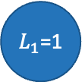
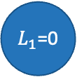

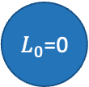

Time Varying
Conditional Parallel Trends
2016 Expanders
2014 Expanders
2015 Expanders
$L_{2}$=0
$L_{1}$=0
Y_{a}
2014
2015
2016
2017
Expanders
Y_{a}
$L_{2}$=1
$L_{0}$=0
2014
2015
2016
2017
Have yet to expand or
did not expand
Y_{a}
2014
2015
2016
2017
Y_{a}
$L_{2}$=0
$L_{1}$=1
Post State Expansion
2014
2015
2016
2017
Y_{a}
2014
2015
2016
2017
Y_{a}
$L_{2}$=1
2014
2015
2016
2017
Y_{a}
2014
2015
2016
2017
Notes:
Until recently, SNMMs were only identified under a sequential exchangeability (or no unobserved confounding) assumption. But in our example and others this assumption is not realistic.
Recently, it was shown that SNMMs can also be identified under a time-varying conditional parallel trends assumption, which is a generalization of the parallel trends assumption shown earlier. So, this slide illustrates the conditional parallel trends assumption needed to identify SNMMs. >>
At each time, parallel trends needs to hold >> conditional on the covariates observed >> up to that time. These are seen by the parallel outcome trajectories

Slide 14
The Question
Methods: DiD
Methods: Econ
Results
Methods: Epi
Blip Model Parameterization
$$γ_{mk}({\overline{L}}_{m})=ψ_{mk}+ψ_{pop}L_{pop}+ ψ_{elig}{{ L}_{elig}}_{m}+ψ_{elig:delay}{{ L}_{elig}}_{m}\left(k−m\right)$$
Effect of expansion at year m on uninsurance at year k is a function of:
Treatment and Outcome Time Specific Intercept +
Baseline log of county population +
Previous income eligibility threshold before expansion +
Interaction of time after expansion and prior eligibility
*all results are population weighted
Notes:
With all these advantages in mind, we applied g-estimation of SNMMs under a conditional parallel trends assumption to our Medicaid expansion question. We parameterized our blip model as follows: We conditioned on time relative to treatment and outcome, the log of county population as of 2013, time-varying prior Medicaid eligibility threshold, and the interaction between time following expansion and prior eligibility threshold

Slide 15
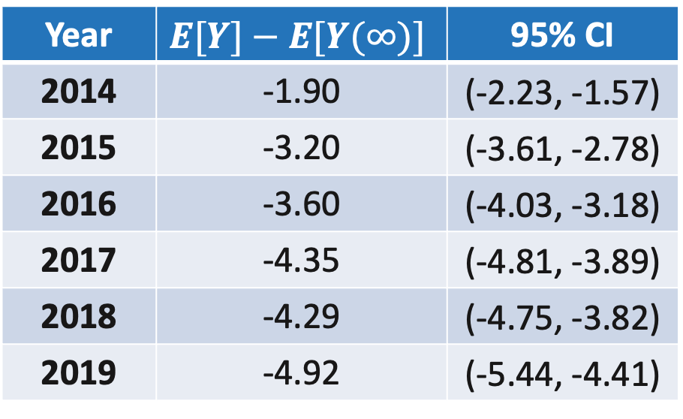
The Question
Methods: DiD
Methods: Econ
Results
Methods: Epi
Observed – Predicted Trend
Effect of ACA Expansion vs No Expansion on County-Level Uninsurance Rates
Lower Impact
Greater Reduction of Uninsurance Over Time
Year | $$E[Y]−E[Y(∞)]$$ | 95% CI
2014 | -1.90 | (-2.23, -1.57)
2015 | -3.20 | (-3.61, -2.78)
2016 | -3.60 | (-4.03, -3.18)
2017 | -4.35 | (-4.81, -3.89)
2018 | -4.29 | (-4.75, -3.82)
2019 | -4.92 | (-5.44, -4.41)
Effect on Uninsurance (%)
Greater Impact
Notes:
We found that Medicaid expansion had a significantly greater effect at reducing county-level uninsurance rates over time compared to never expanding.
>>
As time progressed from 2014 to 2019, a greater reduction of uninsurance rates was observed. These estimates account for both first-time expanders and previous expanders.

Slide 16
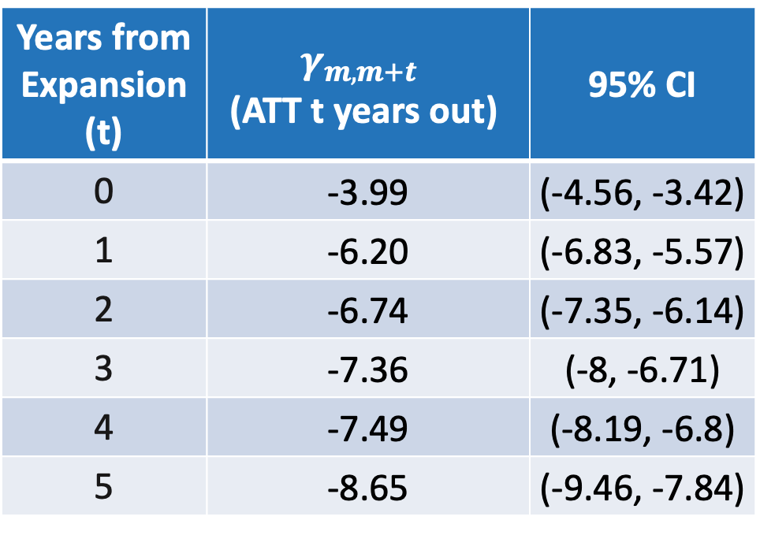
The Question
Methods: DiD
Methods: Econ
Results
Methods: Epi
ATT by Time Horizon
Expansion Effects on County-Level Uninsurance Rates From Time of Expansion
Lower Impact
Years from Expansion (t) | $$γ_{m, m+t}$$ $$\text{(}\text{ATT} \text{t} \text{years} \text{out}\text{)}$$ | 95% CI
0 | -3.99 | (-4.56, -3.42)
1 | -6.20 | (-6.83, -5.57)
2 | -6.74 | (-7.35, -6.14)
3 | -7.36 | (-8, -6.71)
4 | -7.49 | (-8.19, -6.8)
5 | -8.65 | (-9.46, -7.84)
Greater time post expansion, the greater the impact on uninsurance rates
Effect on Uninsurance (%)
Greater Impact
Notes:
Another way of looking at the effect of Medicaid expansion is by looking at the time horizon effects or the treatment effects by time post expansion. Here, all treatment initiations are centered at 0, regardless of the calendar year. The results here show that as follow-up time increases, the effect of Medicaid expansion on reducing uninsurance rates increases.
>>
Said differently, Medicaid expansion reduces uninsurance rates more and more over time. At about 5 years out from expanding, we see about an 8.7% average decrease in uninsurance rates.

Slide 17
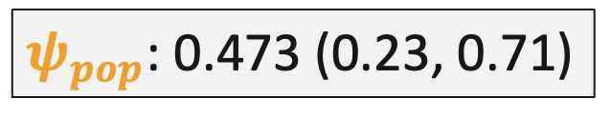
The Question
Methods: DiD
Methods: Econ
Results
Methods: Epi
$$ψ_{pop}$$
Effect of ACA Expansion vs No Expansion on County-Level Uninsurance Rates
Lower Impact
Greater Reduction of Uninsurance Over Time
$$γ=ψ_{mk}+ψ_{pop}L_{pop}+ ψ_{elig}{{ L}_{elig}}_{m}+ {ψ_{elig:delay}}_{k−m}{{ L}_{elig}}_{m}\left(k−m\right)$$
Effect on Uninsurance (%)
$ψ_{pop}$: 0.473 (0.23, 0.71)
Greater county population, less of an impact
Greater Impact
Notes:
When looking specifically at the psi pop parameter, estimated to be 0.473, we found that larger county populations had significantly weaker mediciad expansion effects compared to rural counties.

Slide 18
The Question
Methods: DiD
Methods: Econ
Results
Methods: Epi
Distribution of Prior Income Eligibility
Income Eligibility for Parents and Non-Dependent Adults
3rd Quartile: 65.9% below FPL
More Generous
1st Quartile: 19% below FPL
Less Generous
Notes:
Our second research question was on effect heterogeneity by prior income eligibility thresholds. We compared counties in states with a prior eligibility threshold at the first quartile (19% below the federal poverty line) to those at the third quartile. Another way we contextualized income eligibility thresholds is defining first quartile states as less generous or more exclusionary to Medicaid coverage compared to third quartile states.

Slide 19
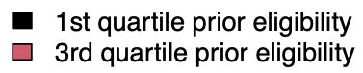
The Question
Methods: DiD
Methods: Econ
Results
Methods: Epi
Effect Heterogeneity by Prior Eligibility
Lower Impact
Effect on Uninsurance (%)
Greater Impact
Notes:
Consistent with prior research, we saw that expansion was more impactful in less generous states at every year of expansion as seen by the black lines relative to the red lines. To note, there were no expansions in 2018.

Slide 20

The Question
Methods: DiD
Methods: Econ
Results
Methods: Epi
Effect Heterogeneity by Prior Eligibility
Later expanders had less impact on reducing uninsurance rates
Medicaid Expansion Treatment Effect Heterogeneity by Prior Income Eligibility Thresholds
Staggered adoption of Medicaid expansion
Time-varying confounding of trends
Can calculate:
Time-varying effect heterogeneity
Effect on Uninsurance (%)
Less generous states (black) experienced a greater impact than more generous states (red)
Notes:
In addition to less generous states experiencing a greater treatment effect than more generous states, We also observe those who expanded earlier had greater reductions of uninsurance rates compared to later expanders
>>
as indicated by the upwards trend of treatment effect by eligibility quartile from 2014 to 2019. So with the current method
>>
we were able to account for staggered adoption of Medicaid expansion,
>>
better address confounding by controlling for baseline and time-varying covariates,
>>
and answer our research question on quantifying effect heterogeneity which previous methods could not

Slide 21
Conclusion
Heterogeneous effects of Medicaid expansion:
Expansion led to greater reductions in county-level uninsurance rates over time
Early expanders experienced greater reductions than late expanders
Less populous/rural counties benefited more from expansion compared to more populous counties
Medicaid expansion had a greater impact in less generous areas
Future work: looking at other effect modifiers (e.g., political lean) and outcomes (e.g., poverty)
G-estimation of structural nested mean models under a parallel trends assumption does more than current methods:
Can adjust for time-varying confounding of trends (i.e., uses a weaker parallel trends assumption)
Can answer questions about time-varying treatment effect heterogeneity
Notes:
To summarize, we estimated that Medicaid expansion led to greater reductions in county-level uninsurance rates over time, that early expanders experienced a greater treatment effect than later expanders, that less populous counties or rural counties benefited more from expansion, and, in less generous states, expanding Medicaid had a greater impact on uninsurance rates compared to more generous states. I want to point out that none of these results are surprising but what I think is really cool and what I hoped to have shown you all is the fact that we can actually estimate treatment effects and effect heterogeneity combining the best of epi and econ methodology.
In the future we plan to look at other effect modifiers like county political lean and we plan to assess other outcomes.
Methodologically, the takeaway is that SNMMs can answer more questions than comparable DiD methods, in particular about time-varying effect heterogeneity and under a weaker parallel trends assumption. And those questions can actually matter!

Slide 22





Special Thanks to:
Zachary Shahn
Mustafa Hussein
Dahlia Remler
Samantha Raymond
SER
Columbia University, Mailman School of Public Health: Susser Stein Inclusion Award
Shahn et al.
Twitter: @meghademiology

Slide 23
Thank you
Contact: meghana.shamsunder@sph.cuny.edu
Twitter: @meghademiology

